Slide 1

Notes:
Good morning, everyone
We proud to present our internship
First, let us introduce ourselves.
And there will be time for questions at the end of the presentations.

Slide 2
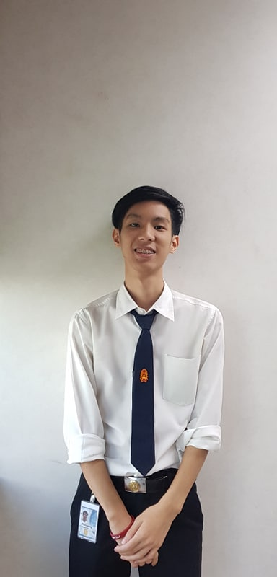
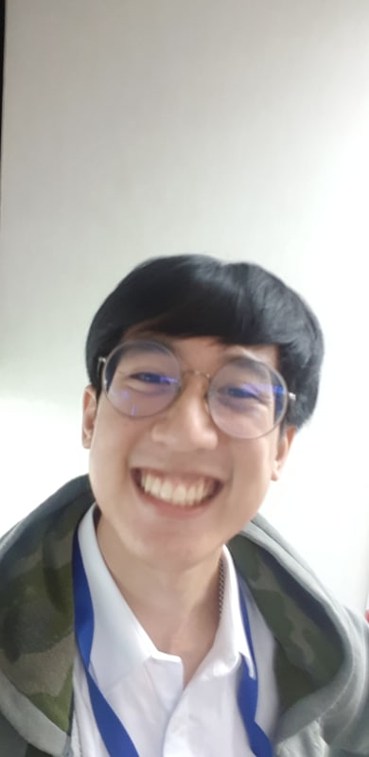
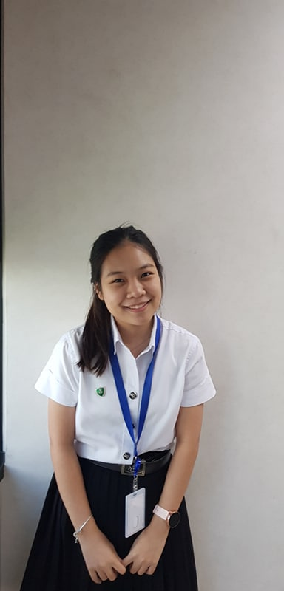
Introduction
Phanupong Rangsanseri
Warrawit Patanavanich
Weeya Weerawatpruchya
IT KMITL
Computer Engineer KMITL
Computer Engineer KU
Earth
Joe
Boo

Slide 3

Agenda
Internship expectation
Team background
Pain point & Solution
Work process
Demo
Intern life
Notes:
This is agenda of our presentation. we have 6 topic . Internship expectation ,team background , pain point and solution ,work process, demo and last one intern life

Slide 4
Internship expectation
Team
background
Work
process
Intern
life
Internship
expectation
Pain point
& Solution
Demo

Slide 5

Expectation
Working
experience
Technical
skills
Finding myself
New friends
Notes:
So ,First let start with our expectation. Technical skill, working experience, new friend and finding myself
about technical skill
Joe: for me . I never use agile and scrum to develop software before so I want to know
why we use agile and how to implement them to a real working enviroment
Earth: I expect to learn about software development, cloud technology, container technology, DevOps process and agile in practical
Boo: and for me I expect to learn project management and learn business process.
next about working experience
we think hard skill can be learn by ourselve but a soft skill we can learn from real working environment , obstacle that we have encountered and how we work with others.
New friend
In ExxonMobil we not work alone so we expect to work with others and make a new friend from internship
Last one finding myself
In university we only learn about coding and programming. But we never work with real business process before. We want to know that we love only coding or also love to work with business process too.

Slide 6

Team background
Team
background
Work
process
Intern
life
Internship
expectation
Pain point
& Solution
Demo

Slide 7

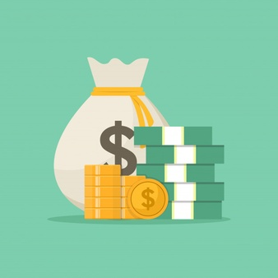

Financial Upstream SAP
EMIT Financial
Upstream SAP
Upstream business
Notes:
ExxonMobil's Upstream is a global leader in the exploration, development, and production of oil and natural gas resources.

Slide 8


Financial Upstream SAP
Polaris
Supernova
Thotsakan
4 teams
Scrumblers
Notes:
And our team, EMIT FI Upstream SAP, we have 4 team Thotsakan, Scrumblers, Supernova, Polaris to helping each other. Which each team is responsible for support in different regions. And we are in Thotsakan team (Thailand) which support In Asia Pacific

Slide 9










Thotsakan
Scrumblers
Supernova
Users
Dispatcher
Polaris
Ticket
IT Console
Notes:
When user have any problem . They will send that problem to our team and we call that a ticket and we have ticket dispatcher who monitor and assign that ticket to team member
every business run by financial right ? So if we have a ticket it’s mean we have a problem that it will make business stuck and delay

Slide 10
Why tickets are important?
Notes:
Why tickets are important?

Slide 11
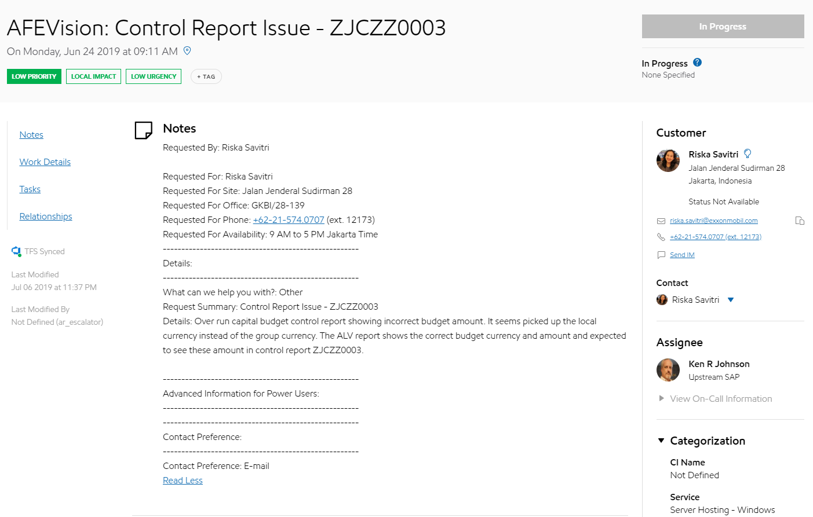
Ticket
Summary
Customer
Details
Notes:
Let’s take a look at real ticket
In the ticket will have summary of tickets (title), detail that customer write to explain more about their problem, customer who open the ticket

Slide 12
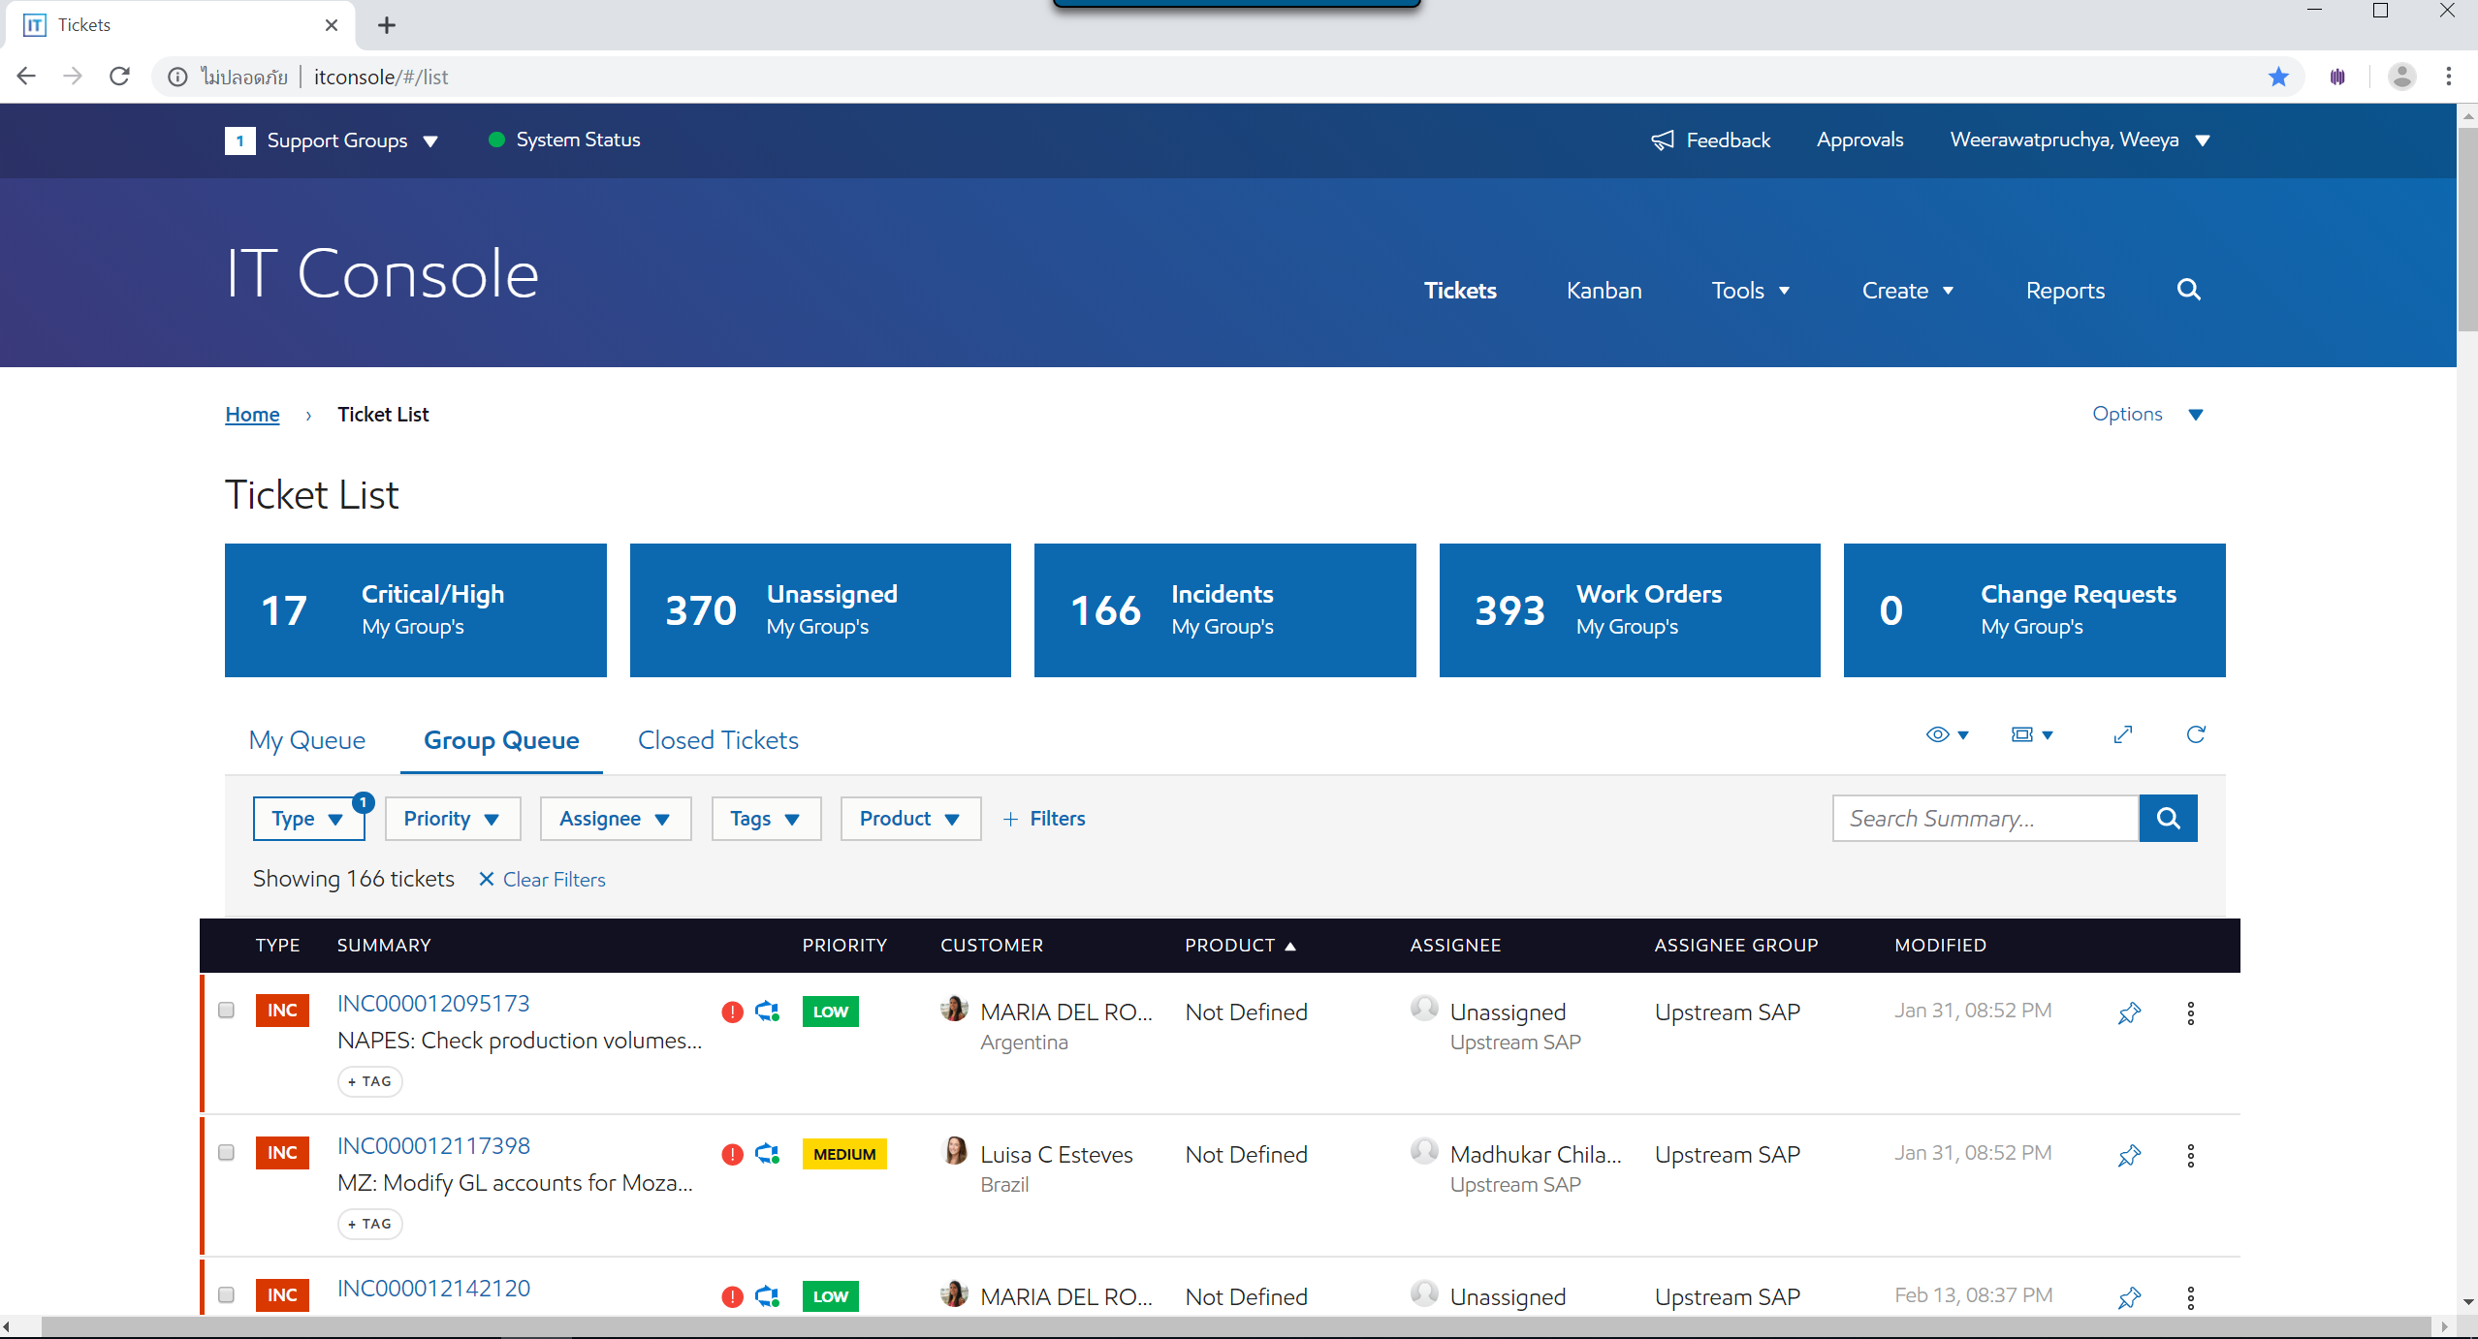

IT Console
Users
Notes:
We have tickets and we have IT console the website for display all tickets from users
And this is the real IT console as you can see display all tickets here… and have a filter
But IT console not suitable for our team structure that have 4 sub team ….. All tickets from 4 team in the same page

Slide 13




Classify & Assign tickets
?
FI Upstream SAP
4 sub-teams
?
Thotsakan
Scrumblers
Supernova
Polaris
Notes:
Let’s see how our team classify & assign ticket
We have 4 dispatcher & hundred of tickets

Slide 14
Pain point & Solution
Team
background
Work
process
Intern
life
Internship
expectation
Pain point
& Solution
Demo

Slide 15
Pain point
Team classification is done manually
Unnoticed reassign ticket
Monitor all time
Unknown Contact point

Slide 16

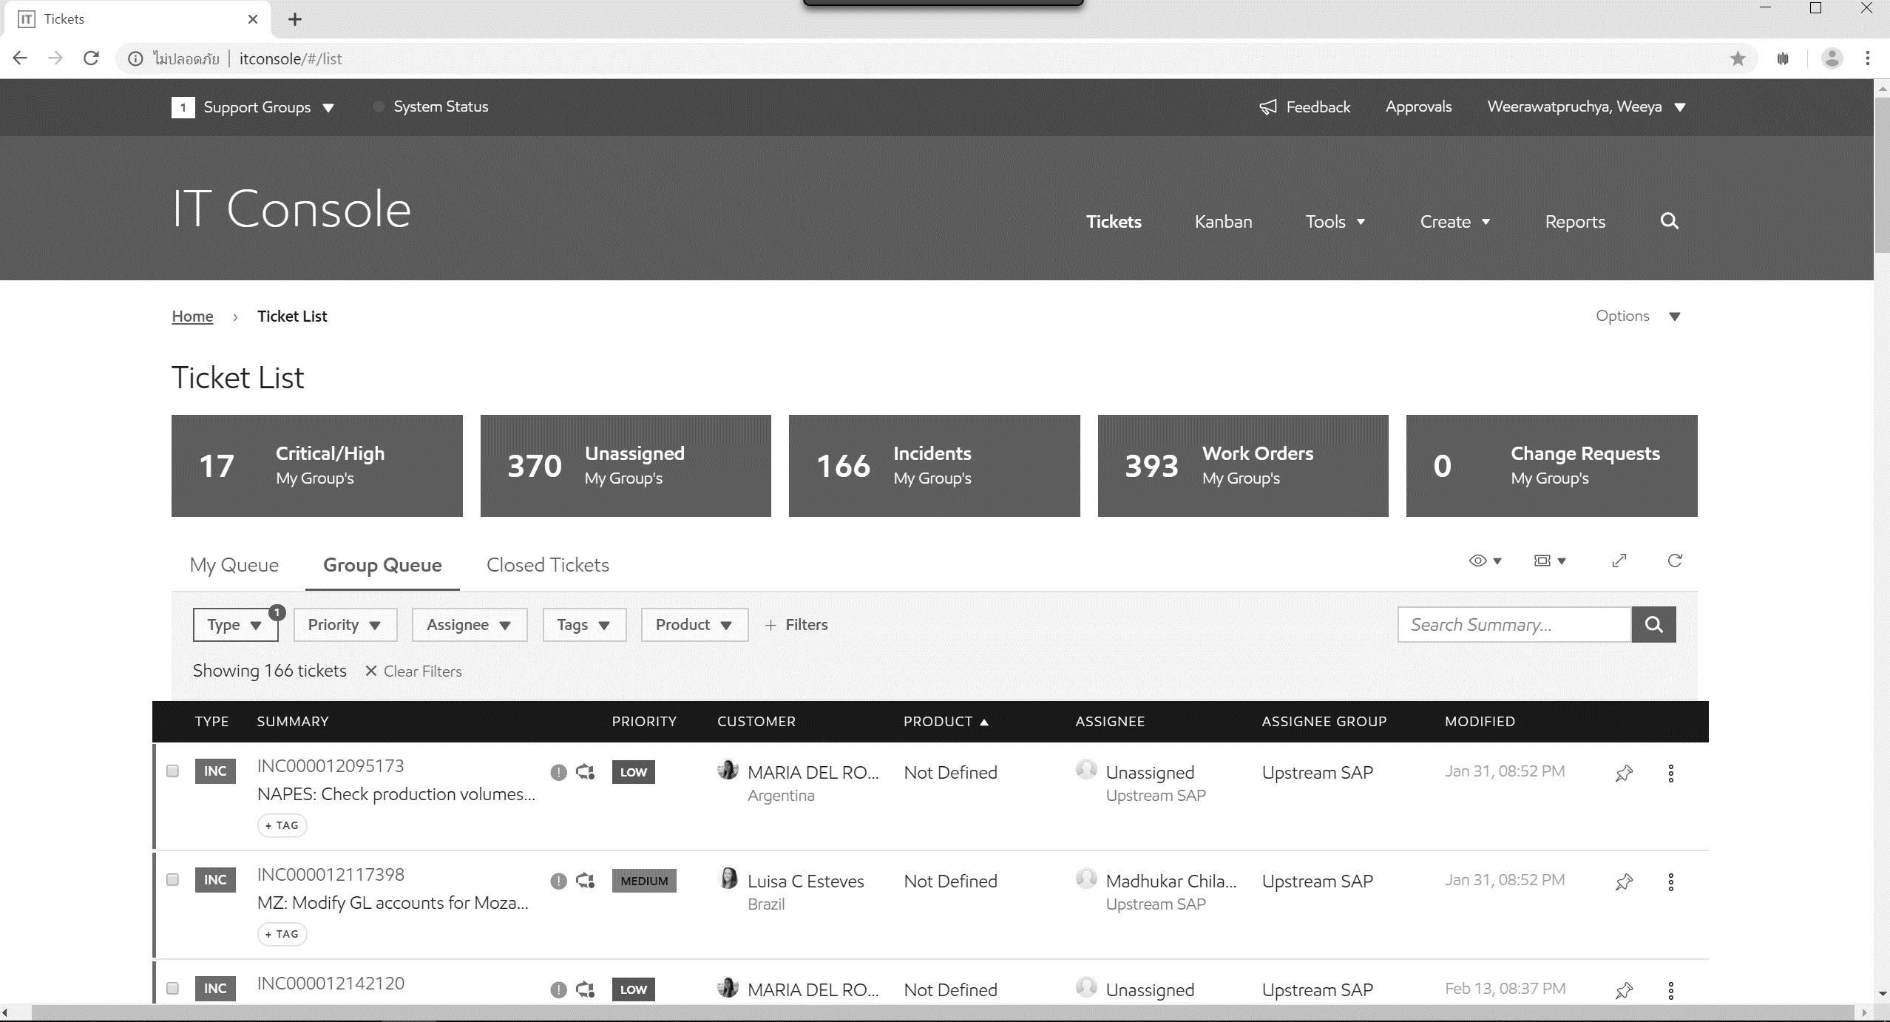
Ticket dispatcher’s life
Notes:
Ticket dispatcher’s life…
In one day ticket dispatcher have to open IT console & start with the first unassign ticket. He have to classify & assign ticket to his team. So he have to read each ticket carefully.

Slide 17
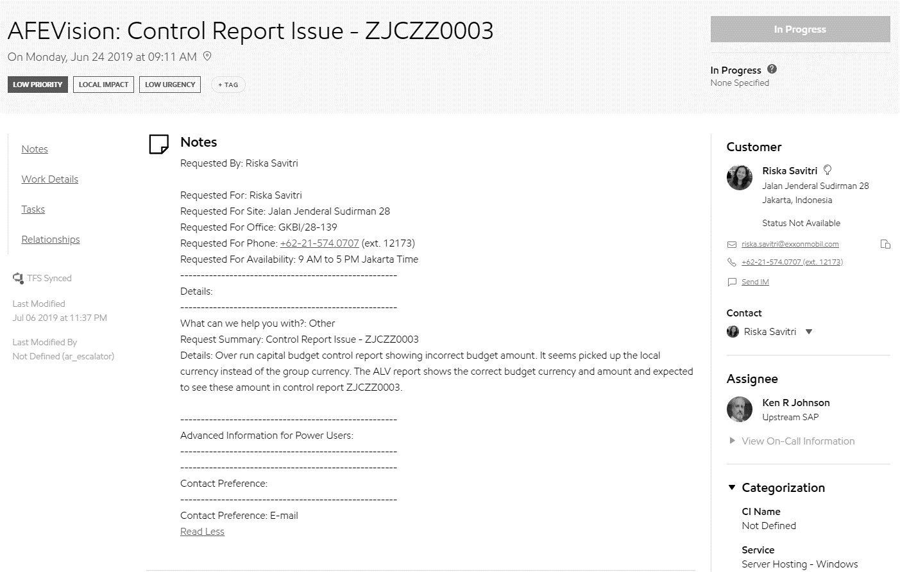
Ticket dispatcher’s life
Notes
Customer
?
Notes:
He start by reading summary & notes line by line to find any keyword, any company code or impacted country & look at customer too.
If the ticket belong to his team he will assign to his team member if not he just skip this ticket and back to fist page.

Slide 18
Ticket dispatcher’s life
1st Pain point
Notes:
And continue doing the same thing ticket by ticket manually
That is the first pain point.

Slide 19
Ticket dispatcher’s life
Yesterday …
INC000012142120
Notes:
He continue reading ticket…
Until the last ticket that he have already done yesterday that he have to remember by himself.

Slide 20
Ticket dispatcher’s life
2nd Pain point
Done
Notes:
Sometime ticket reassign from other support group and it come in the middle … & ticket dispatcher maybe unnoticed that ticket
That the second pain point.

Slide 21

Ticket dispatcher’s life
3rd Pain point
Monitor
IT Console
Notes:
Moreover ticket dispatcher have to monitor ticket all the time … have any new ticket come in
& manually refresh IT Console
That is the third pain point.

Slide 22

Ticket dispatcher’s life
4th Pain point
Contact?
Notes:
Sometime when ticket dispatcher have a problem … for example about reassign to other team
He have no idea who he will contact with.

Slide 23
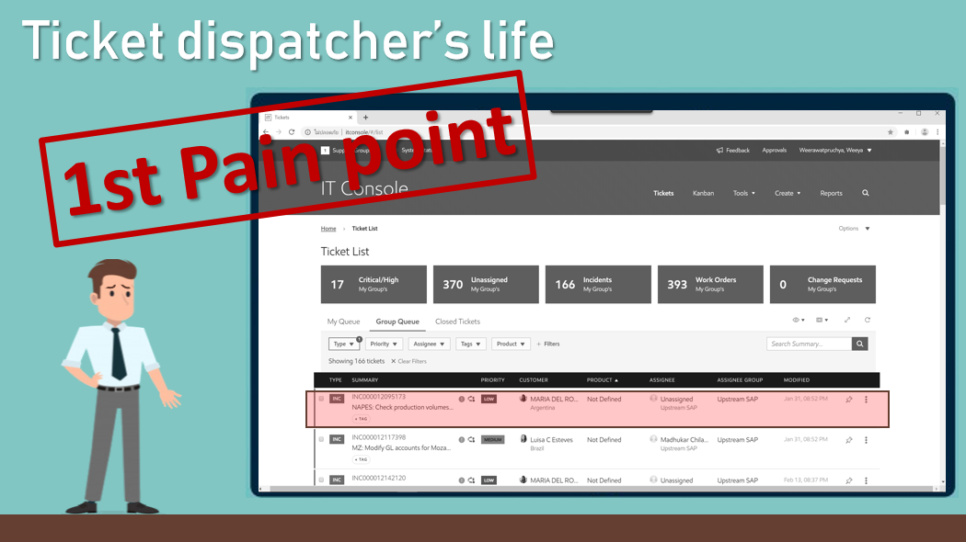
Solution
Team classification

Slide 24
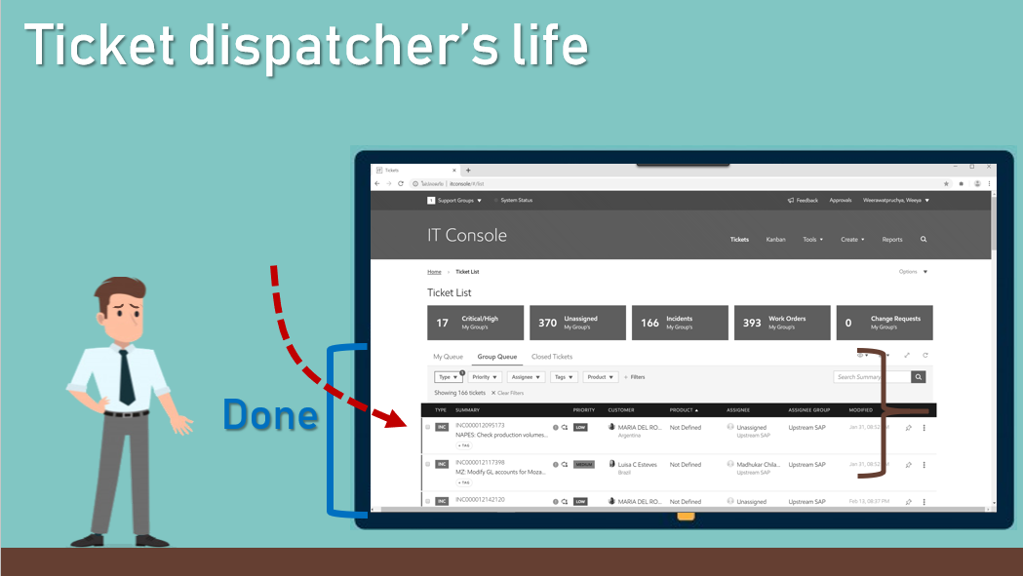
Solution
Sort ticket by modified date
Instead of submit date

Slide 25
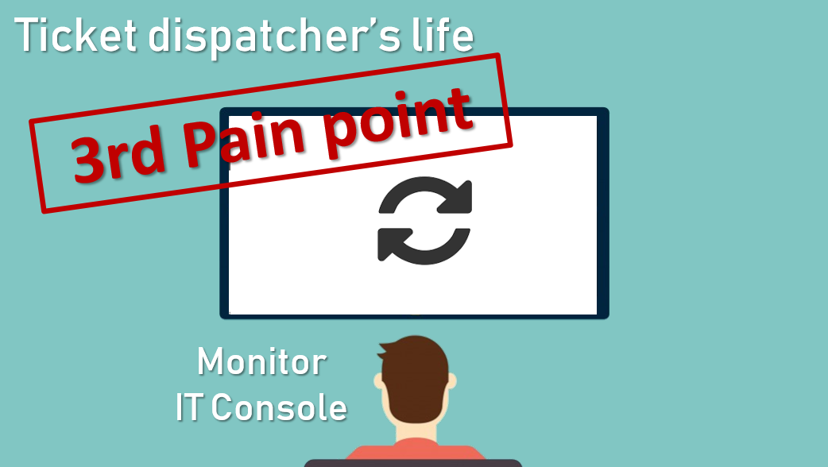
Solution
Notification & Auto refresh

Slide 26
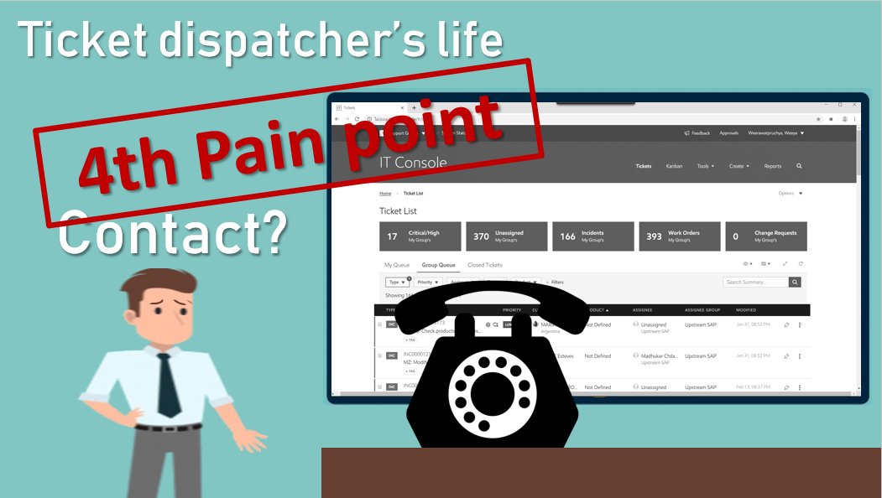
Solution
Display ticket dispatcher

Slide 27
Work process
Team
background
Work
process
Intern
life
Internship
expectation
Pain point
& Solution
Demo

Slide 28




Work process
Agile
methodology
Scrum
framework

Slide 29
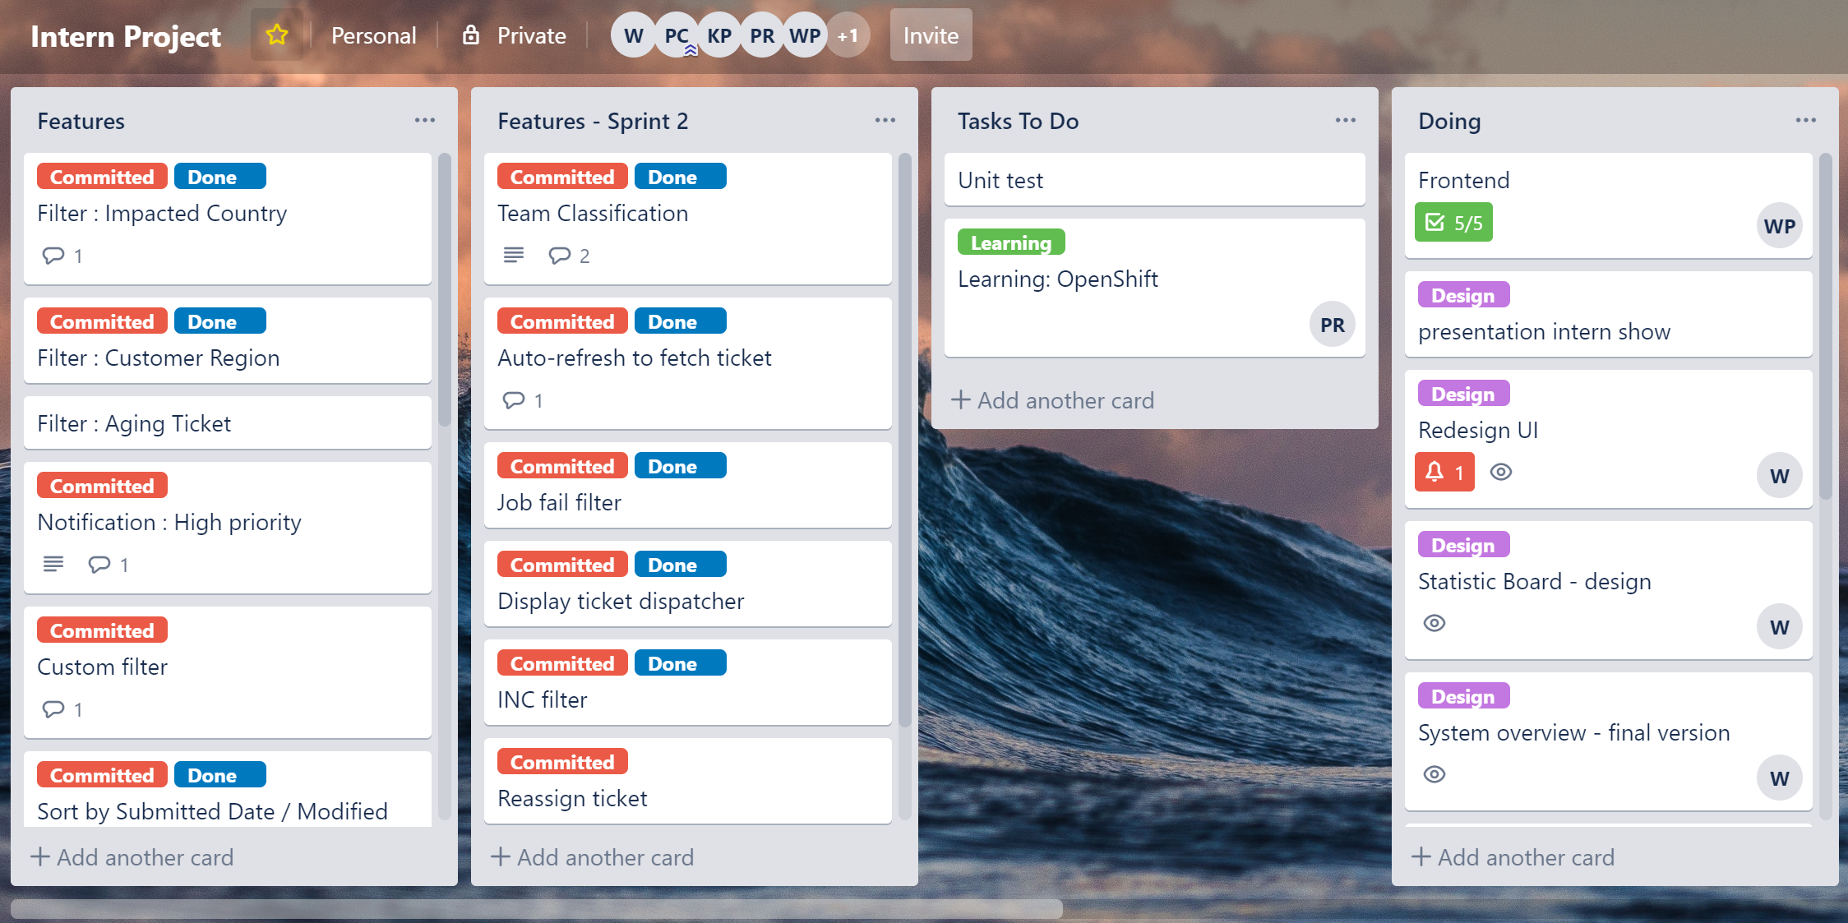

Slide 30
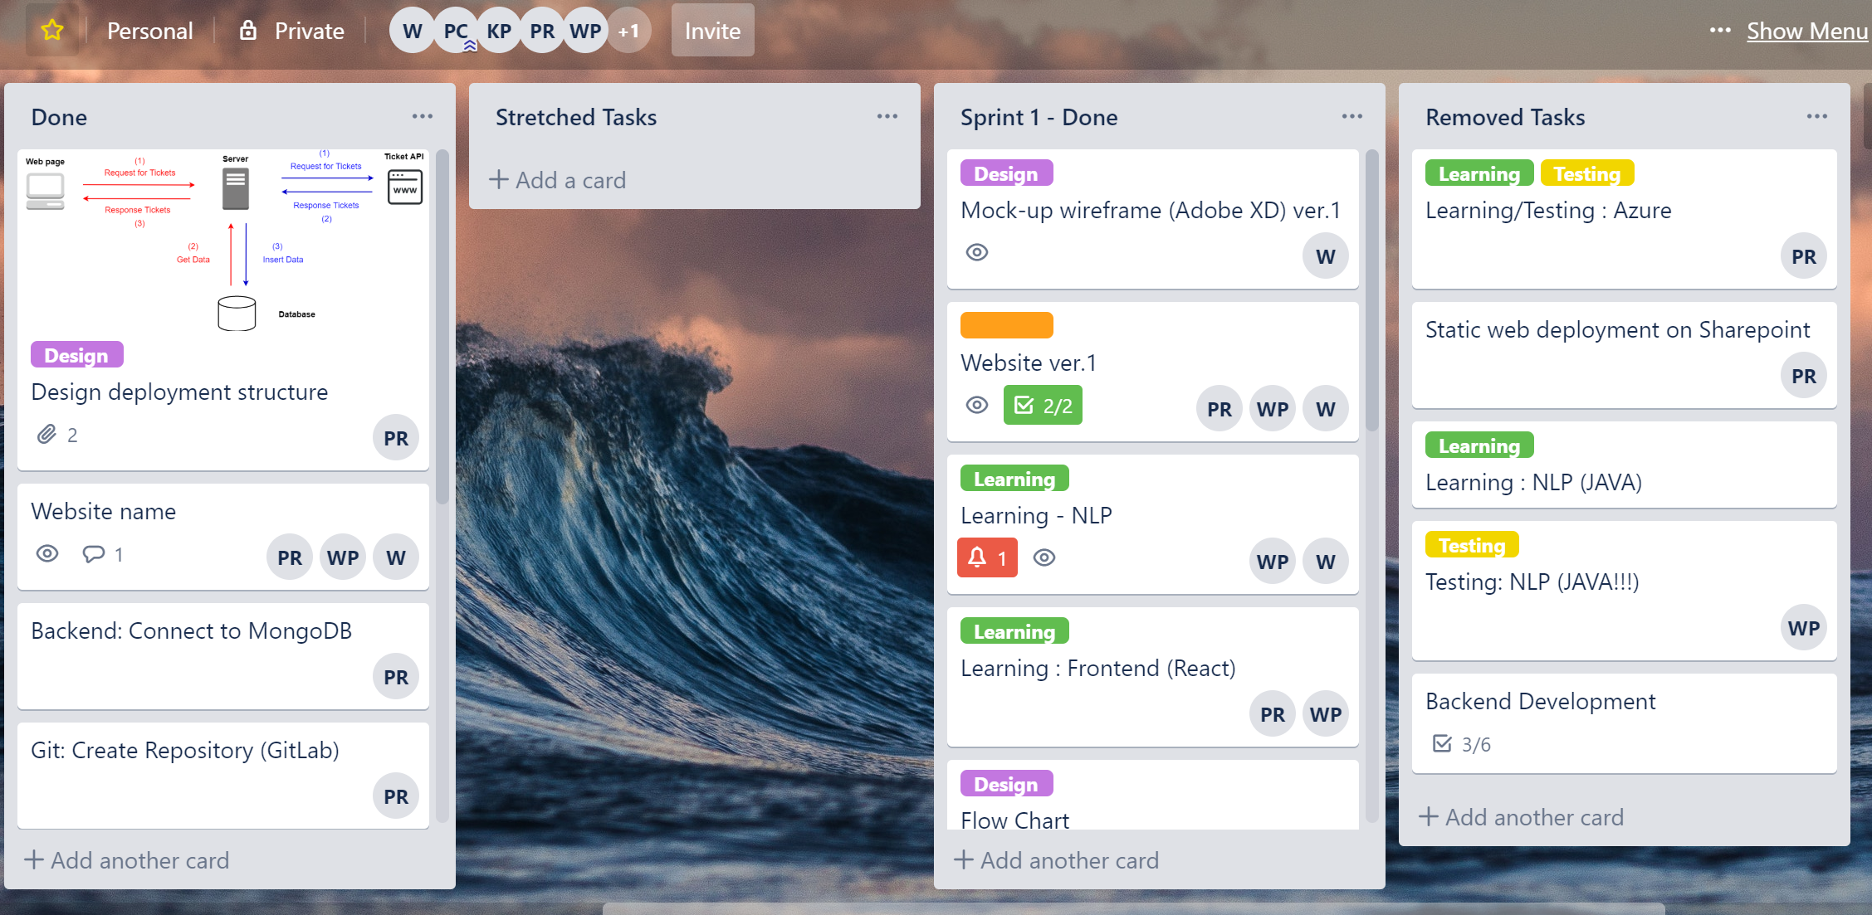

Slide 31
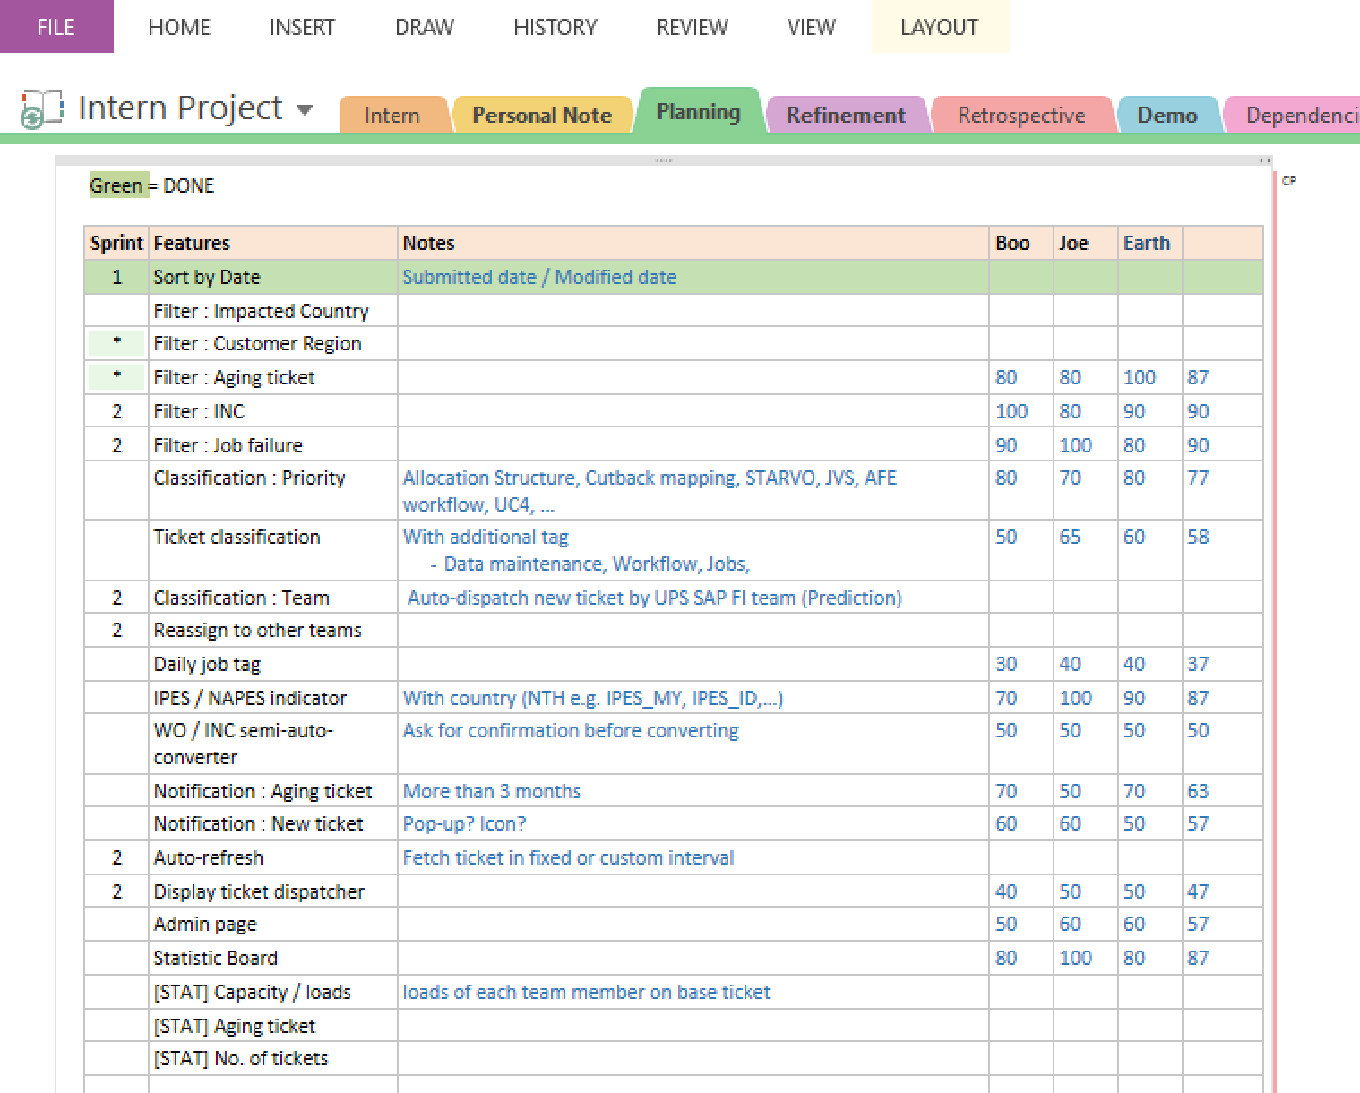
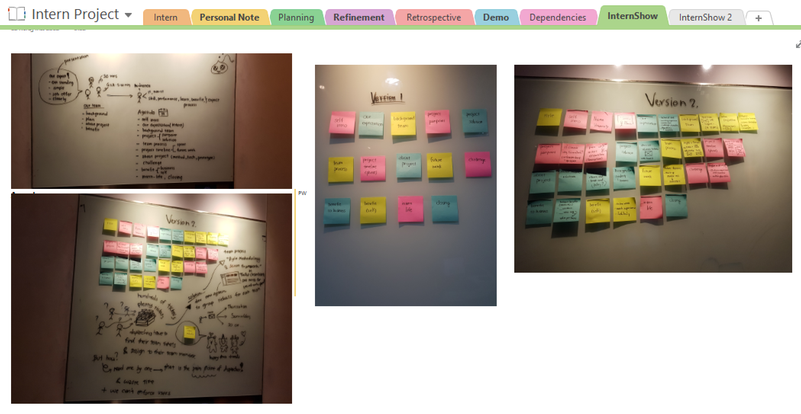

Slide 32
Timeline
Phase 1
Phase 2
2 months
4 months

Slide 33
Phase 1 (2 months)
Sprint 1
Sprint 2
Sprint 3
Gather requirements
Learn development tools
Design wireframe and UI version 1
Design system overview version 1
Make website version 1
Rewrite some logics
Refactor code (optimize and clean code)
Prepare for Interns show presentation
Redesign UI (version 2)
Redesign system overview
Make website version 2
Use version control (GitLab)

Slide 34
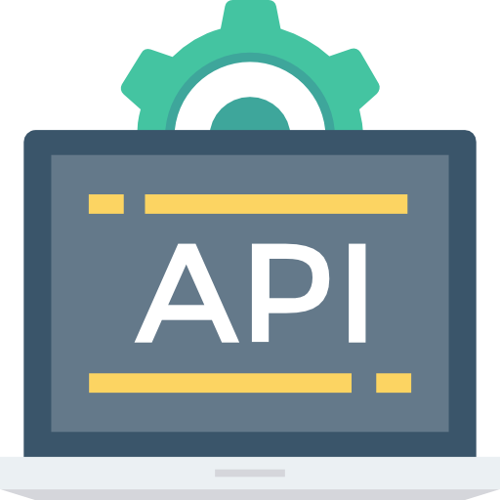



System overview
Ticket API
Webpage
Server
Request for tickets
Request for tickets
Respond tickets
Respond tickets
Get data
Insert data
Database
Notes:
this is a system overview diagram so we split them to 2 processes.it will work in parallel mode .Ok, first we look at the red one. when we open the webpage, it's will request a ticket from backend server and the server will query ticket from database and respond tickets back to the webpage and show them to user so next the blue one is backend process first the backend request all upstream tickets from its console and it's console respond tickets to backend server to classify the team ticket and add team attribute into tickets then store them to the database

Slide 35

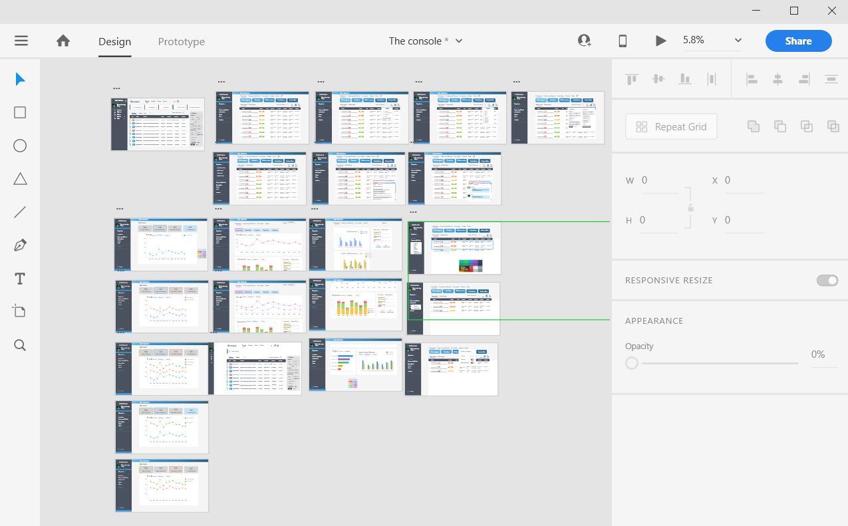
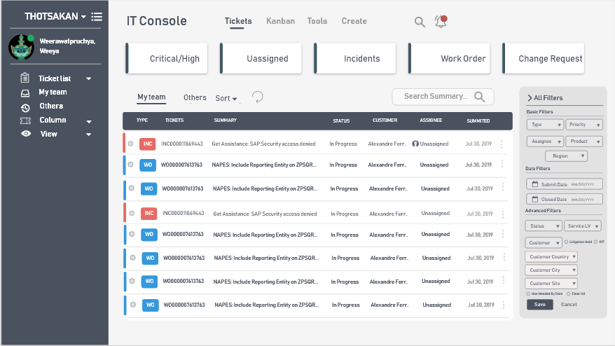
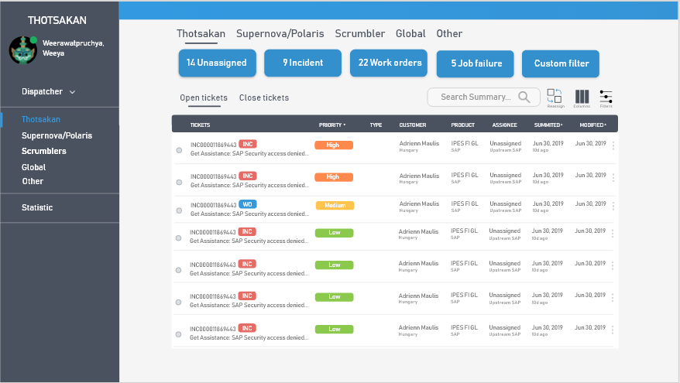
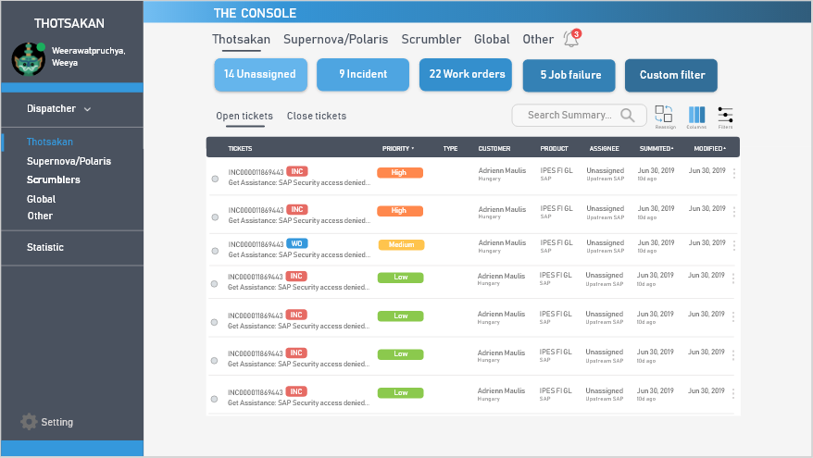
Technologies – Design
Website wireframing
Creating simple interactive click-through prototypes
Adobe XD
Team
Menu bar
Display tickets

Slide 36


Technologies – Front End
React
Building website user interfaces

Slide 37


Technologies – Backend
Python
Python: extracting text and classify team
Flask: for deployment to the web server

Slide 38

Technologies – Database
MongoDB: store tickets data

Slide 39
DEMO
Team
background
Work
process
Intern
life
Internship
expectation
Pain point
& Solution
Demo

Slide 40
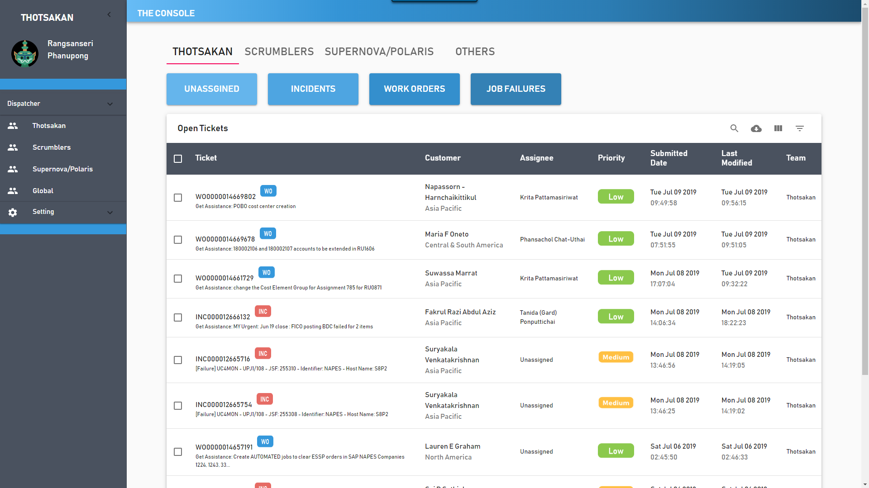
Home page

Slide 41
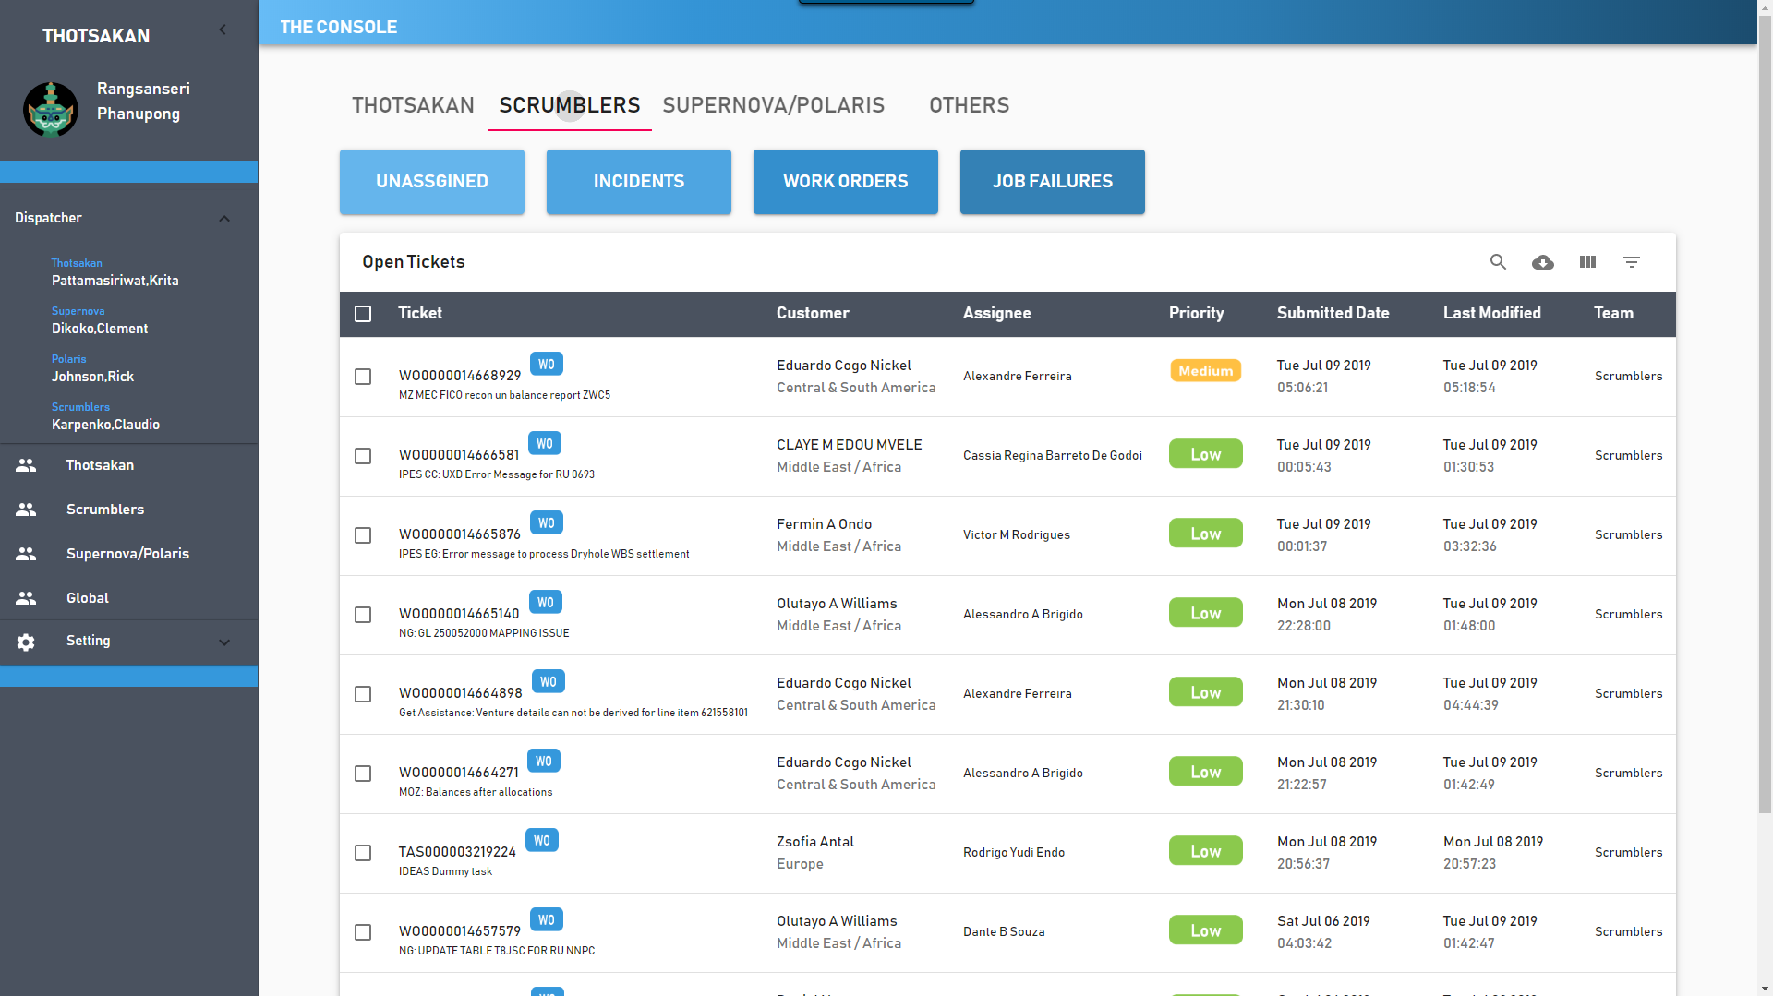
Team classification

Slide 42
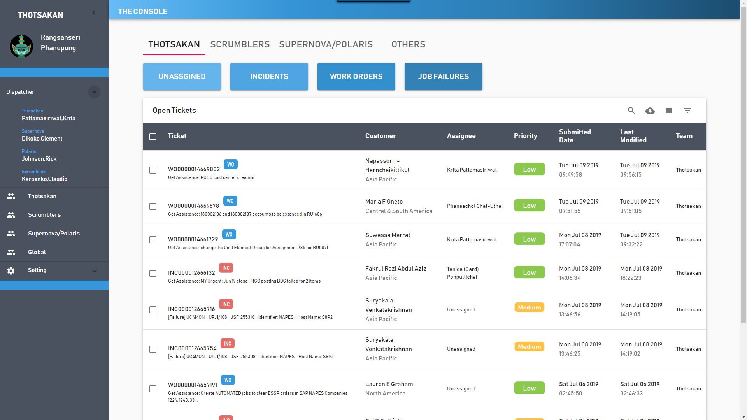
Display dispatcher

Slide 43
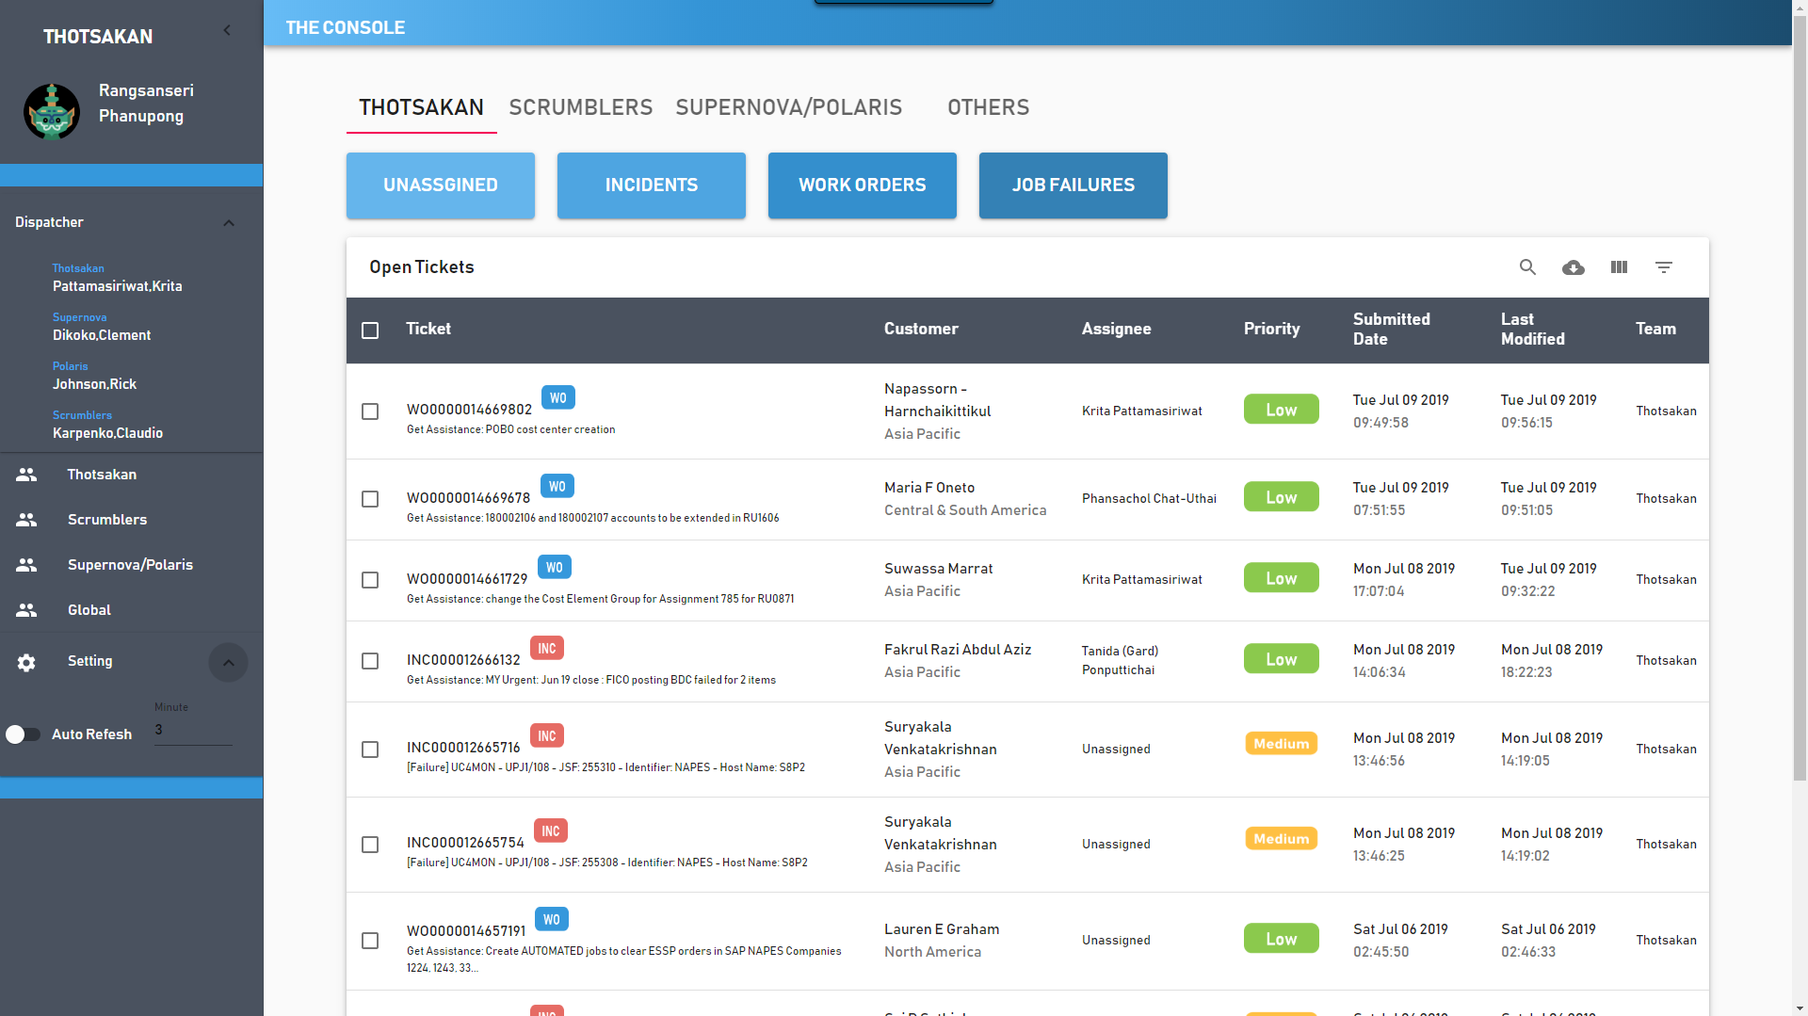
Auto refresh

Slide 44
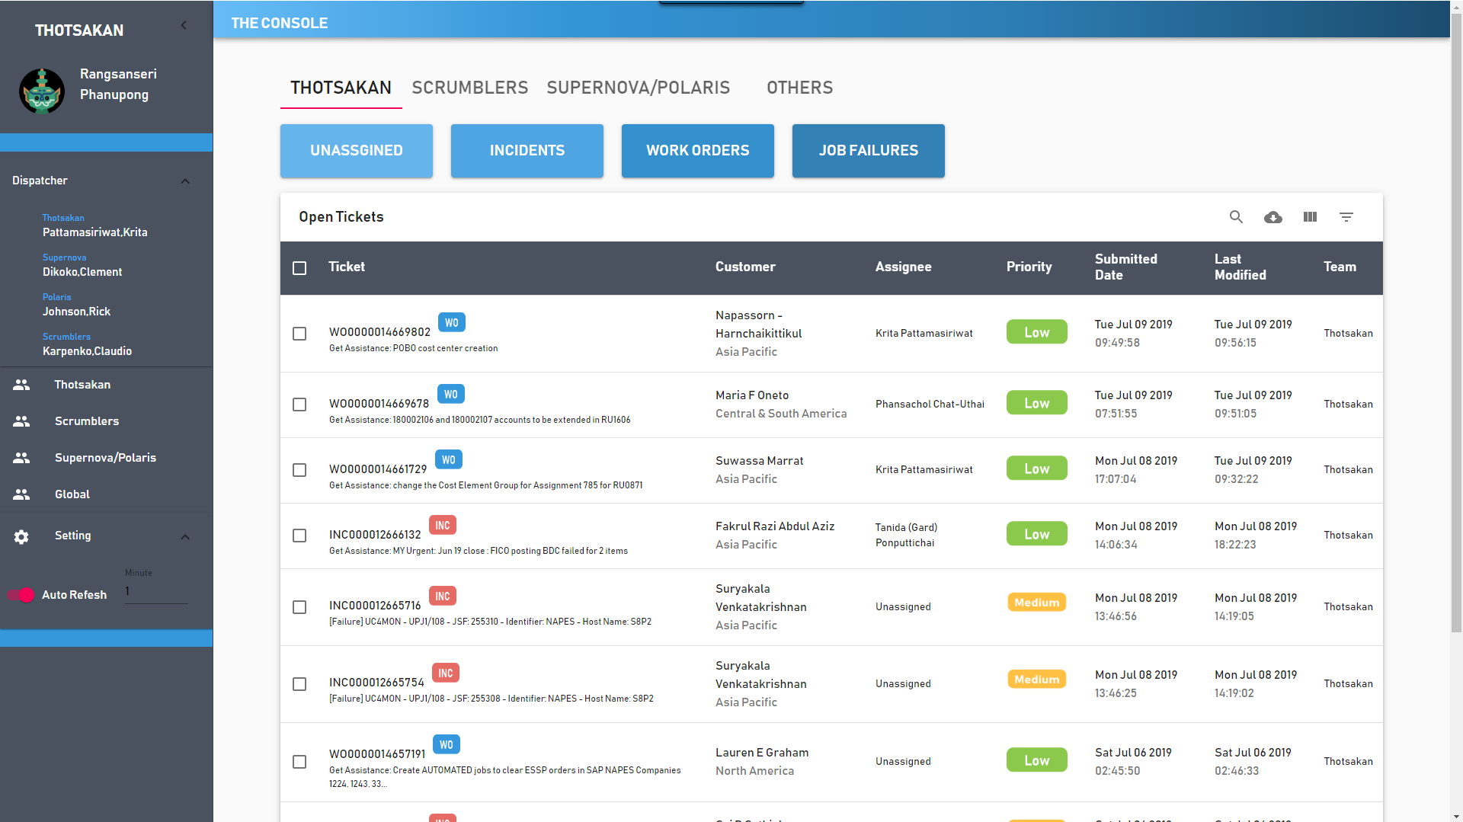
Auto refresh

Slide 45
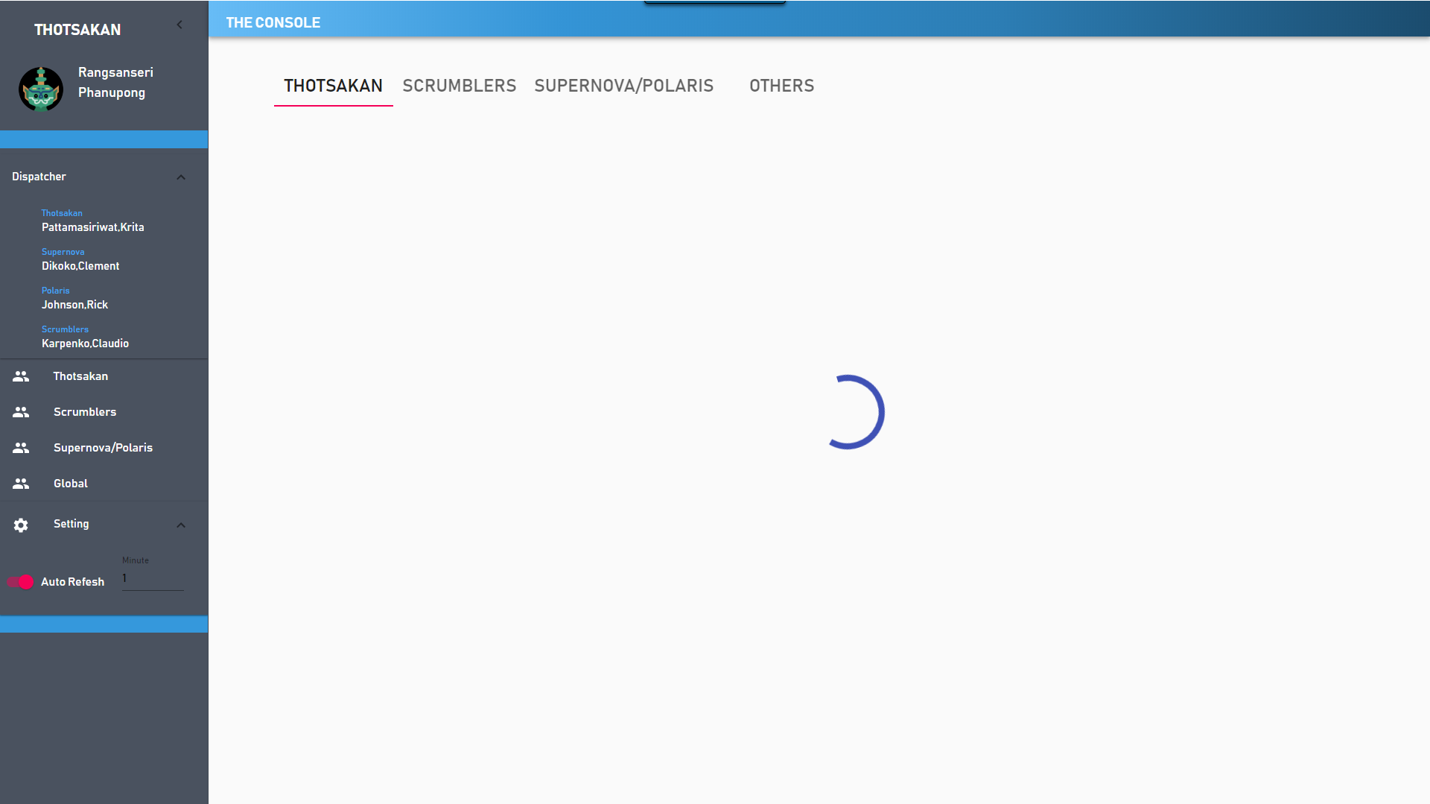
Auto refresh

Slide 46
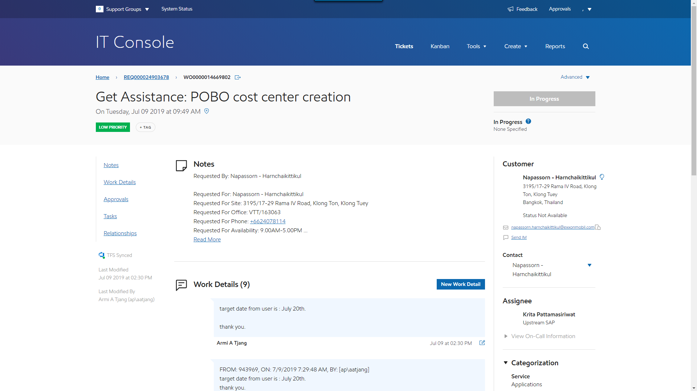
Ticket detail

Slide 47
Future work
Phase 2 (4 months)
Notification
Statistics page
ITSM’s ticket info update
Notes:
Statistics and deploy

Slide 48
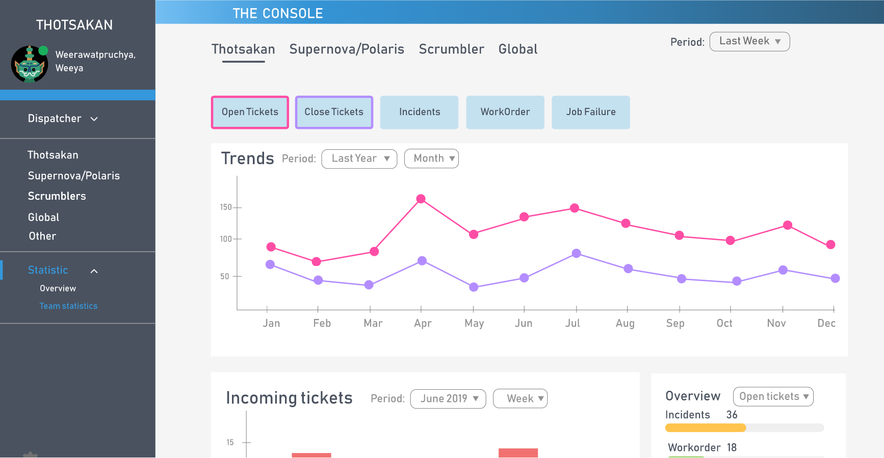
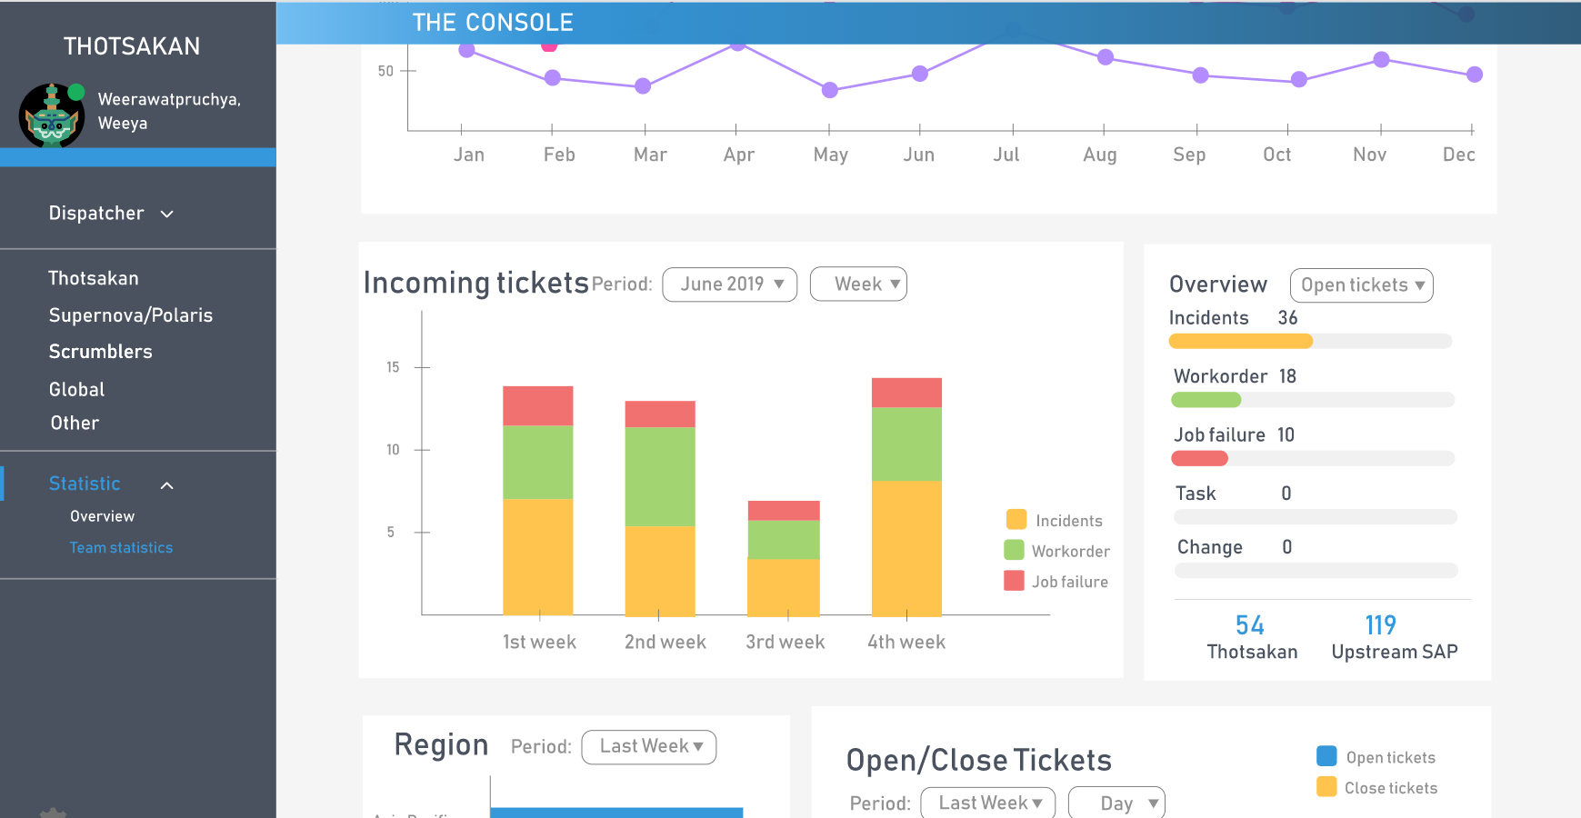
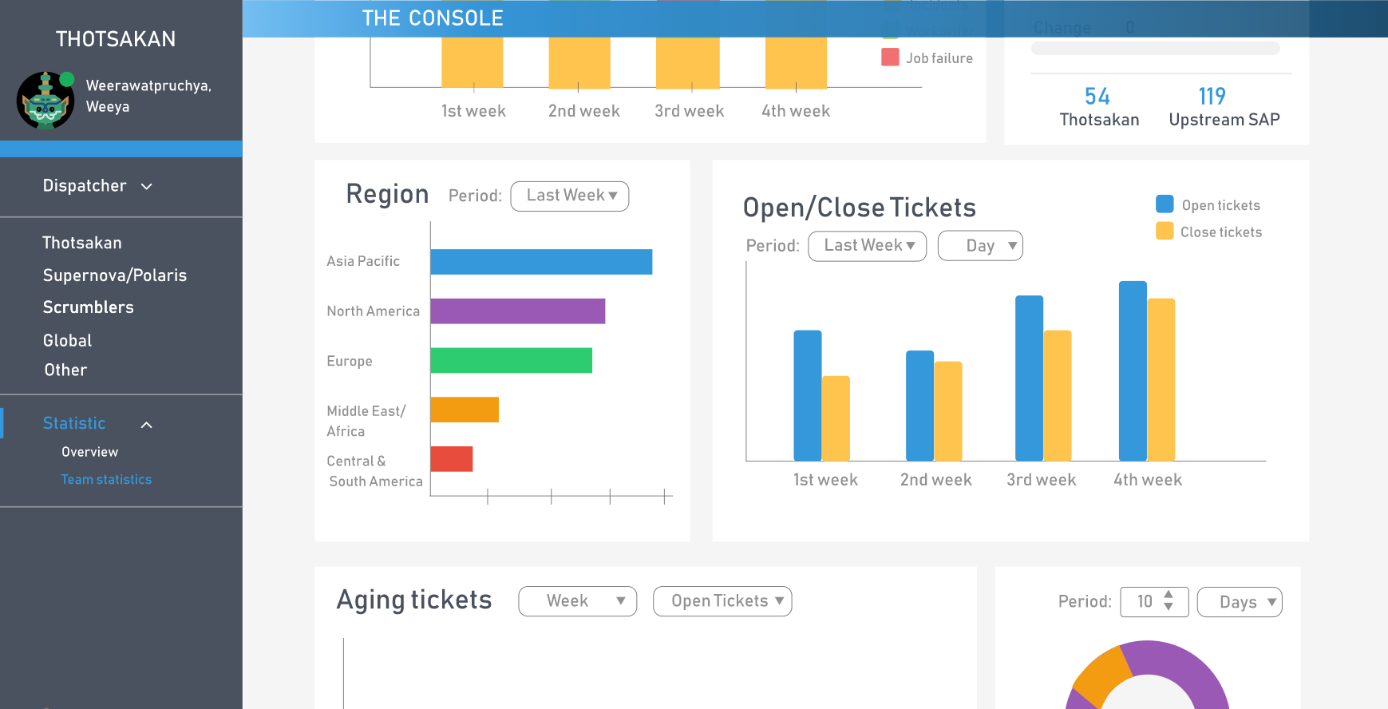
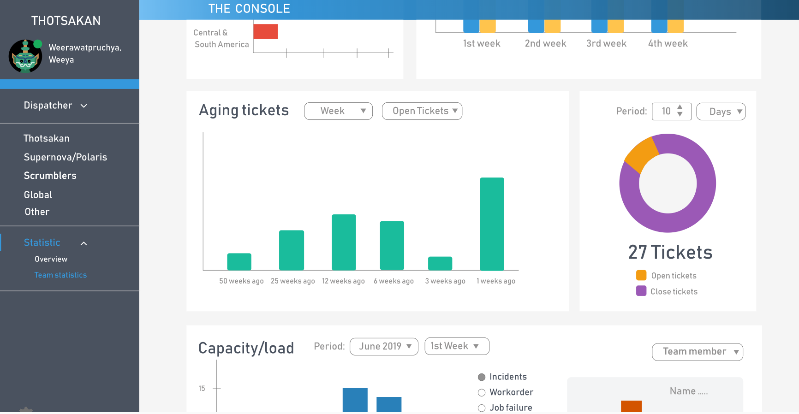

Slide 49


Benefit to team
Reduce times usage
Improve efficiency

Slide 50


Challenge
Collaborations with new friends
Use collaborations tools
Adapt to project's requirement changing
Use agile for project management
Plan daily works
Time limitation
Speak English
Use English in all scrum ceremonies
Notes:
We use collaborations tools example, gitlab to share source code, skype for meeting
We use agile to adapt with changing requirements
For time limitation, we manage it with planning, we plan our daily work in each daily standup. So, we can know times that we have in each day.
And last one, we didn’t speak English too much before. So, we forced ourselves to speak English in every scrum ceremonies

Slide 51
Intern Life
Team
background
Work
process
Intern
life
Internship
expectation
Pain point
& Solution
Demo

Slide 52


What have we learned ?
Technical
skills
Working
experience
New friends
Finding myself
Notes:
What have we learned from internship ?
Joe: I learned about how to create website and how to use agile to develop software
Earth:
Boo:
Working experience:
we encountered with real work environment, pressure, time limitation and finally we can handle it.
New friends:
We met a lot of new friends from this internship. We know how to work with others
Finding myself:
from this internship, we didn’t know what we like. We want more time to find ourselves
And more….
We also learned about how to make a good presentation, improve English language skill such as, we use English in all agile ceremonies, writing email.

Slide 53
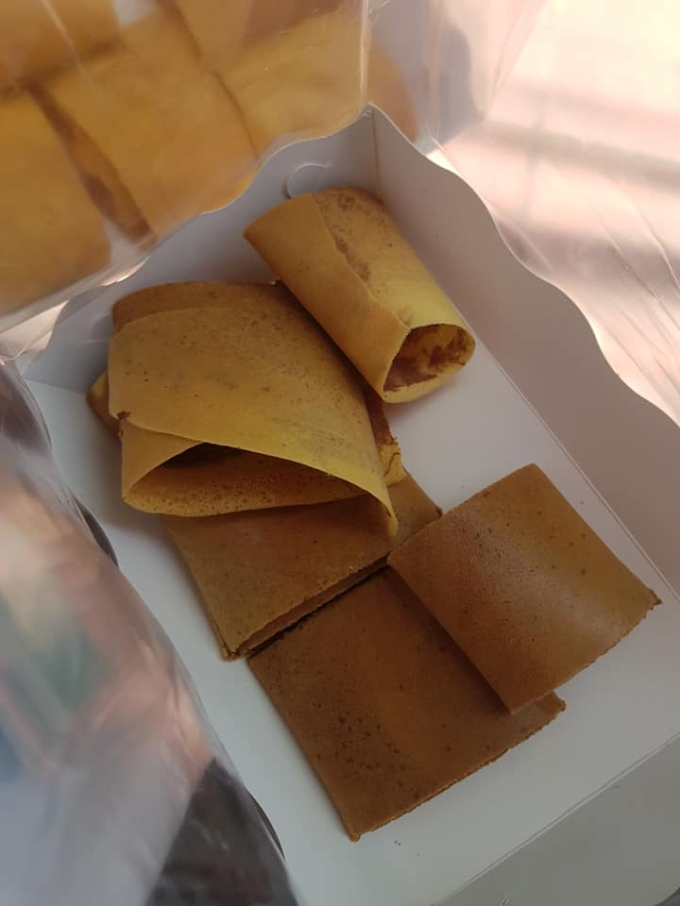
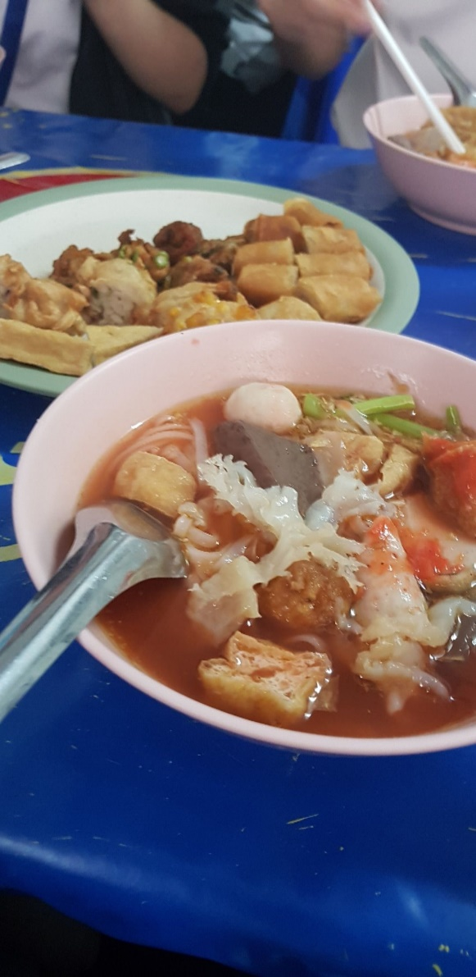
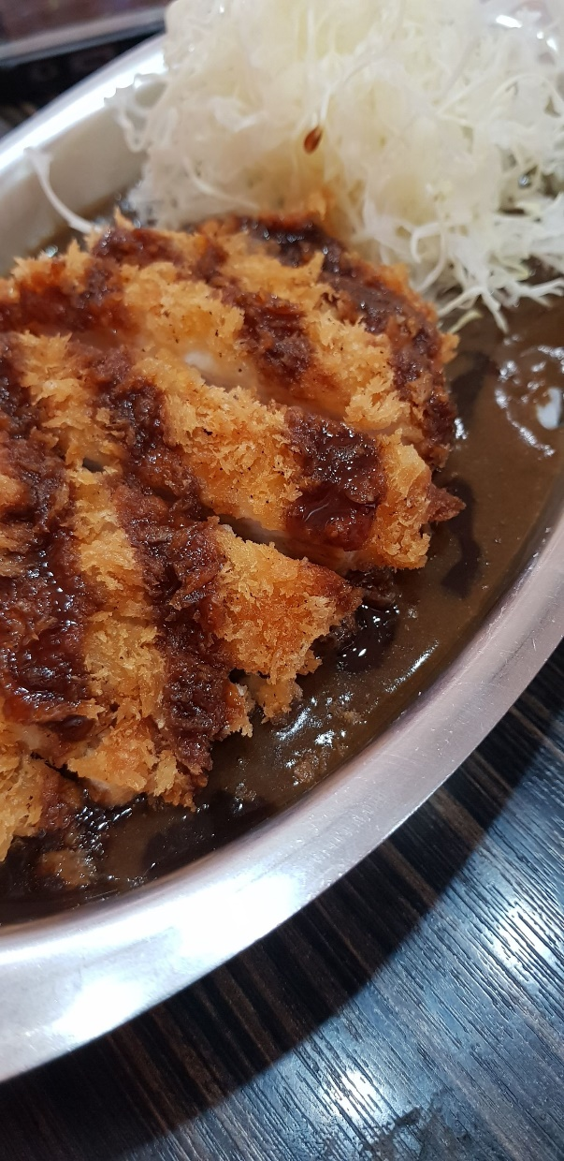
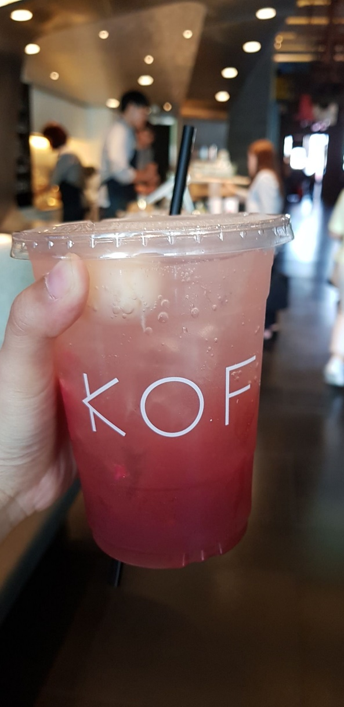
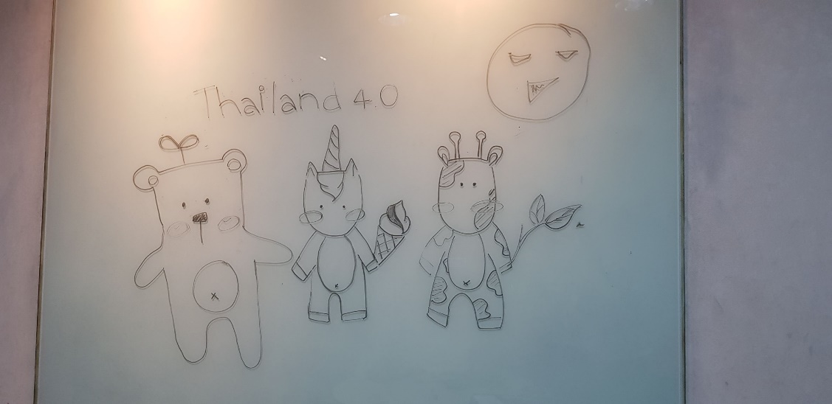
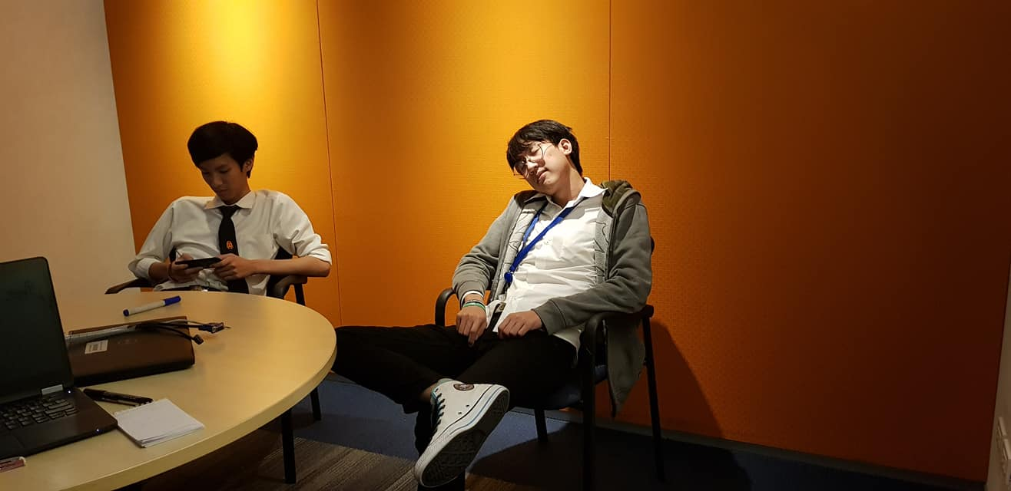
Notes:
In exxonmobil we didn’t do only work, we also do activities with our friends. We have lunch together

Slide 54
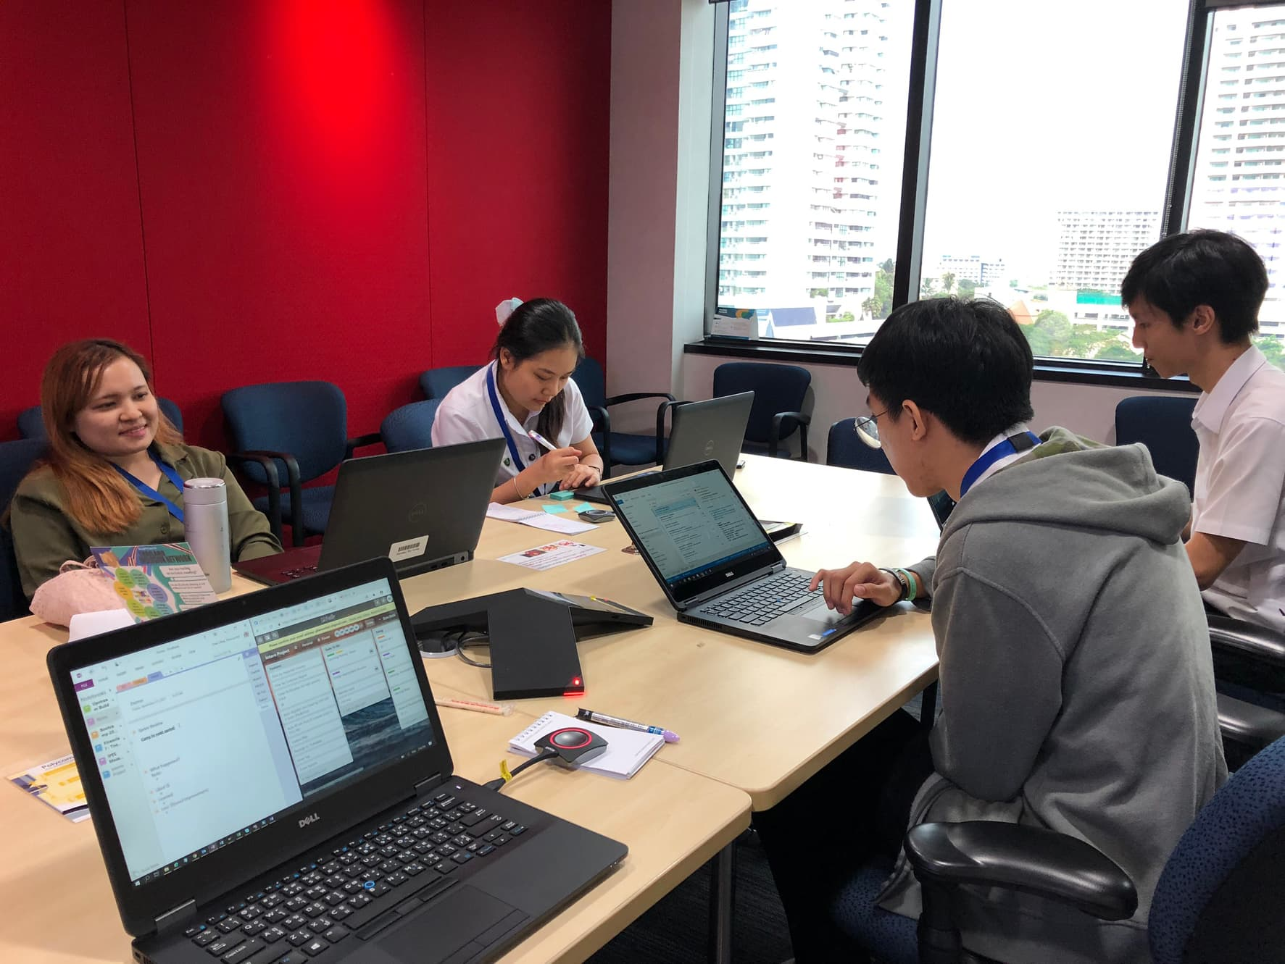
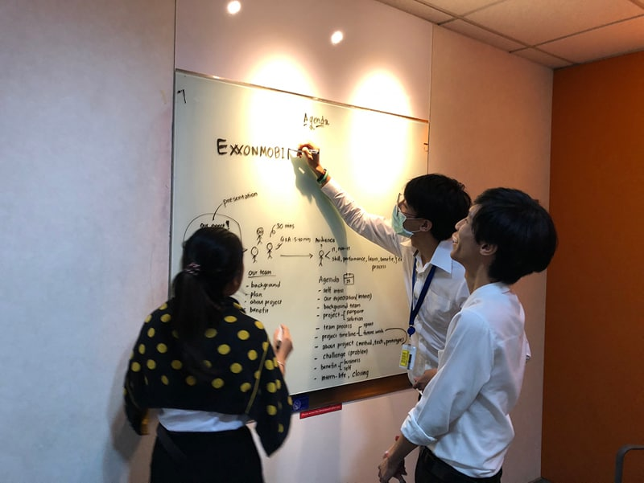
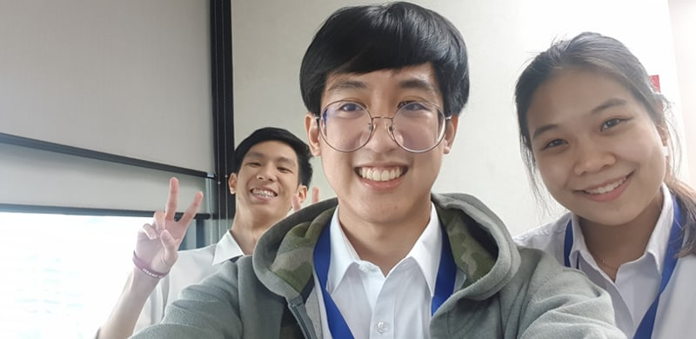
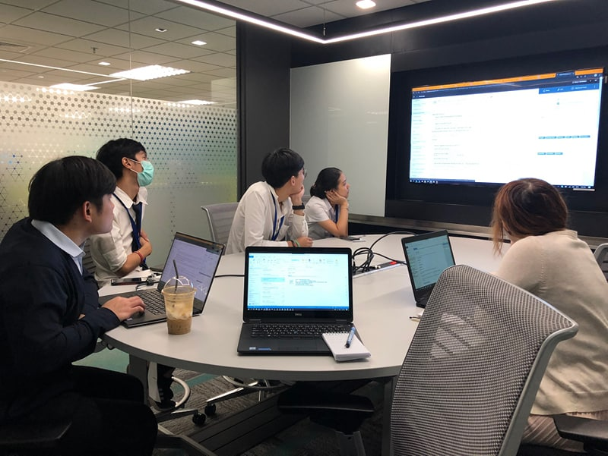
Notes:
Work together

Slide 55
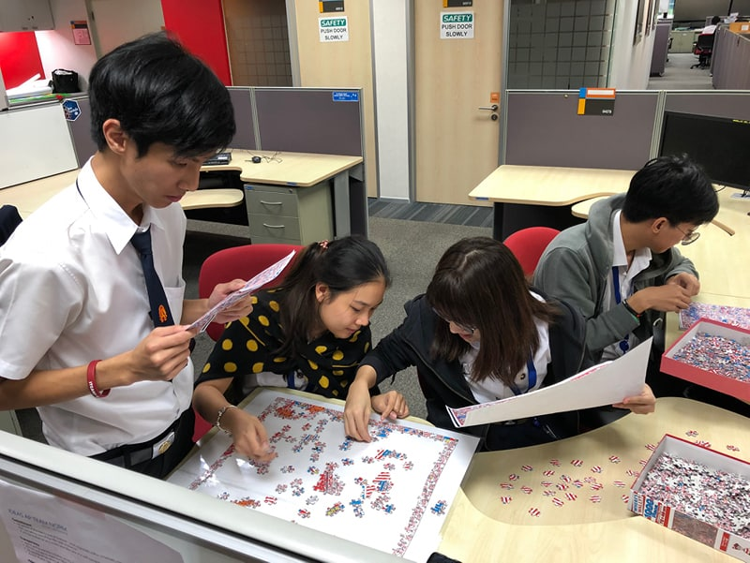
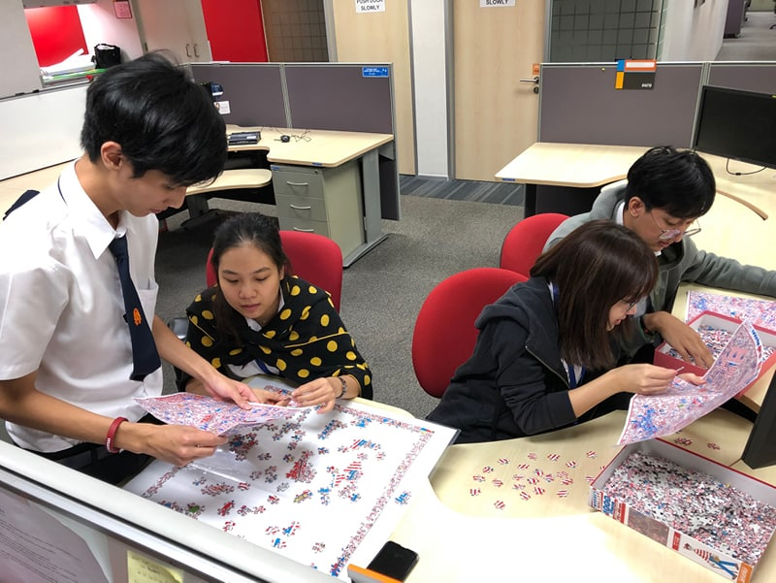
Notes:
And we play jigsaw together, its very funny

Slide 56
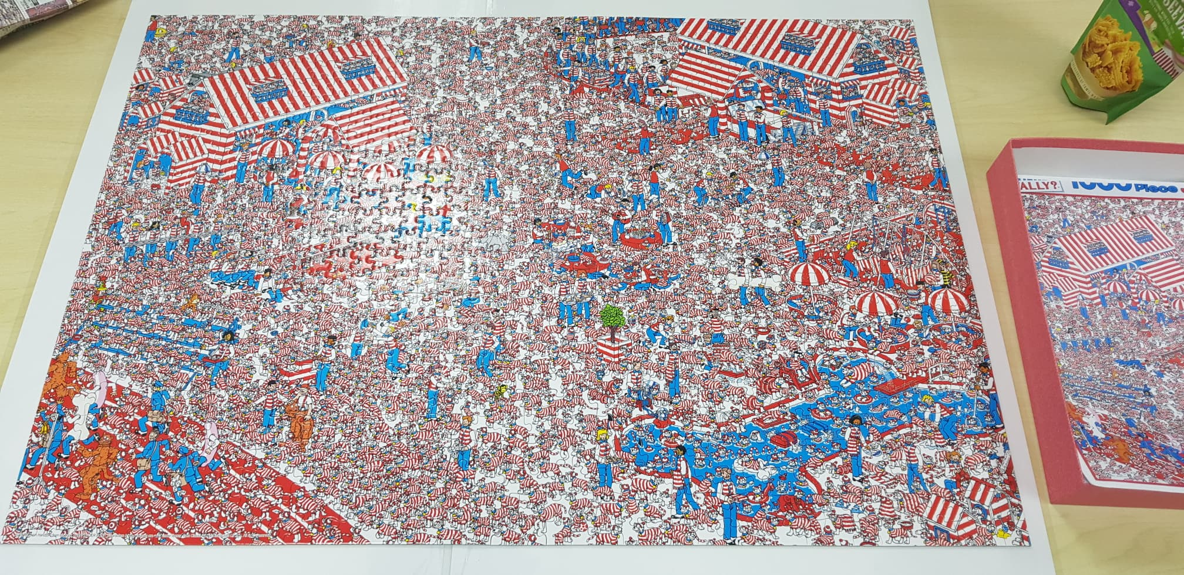

Slide 57
If you only do what you can do,
You’ll NEVER BE BETTER
Than what you are.
-Master Shifu-

Slide 58
Q & A

Slide 59
Team
Menu bar
Display tickets

Slide 60
